Slide 1
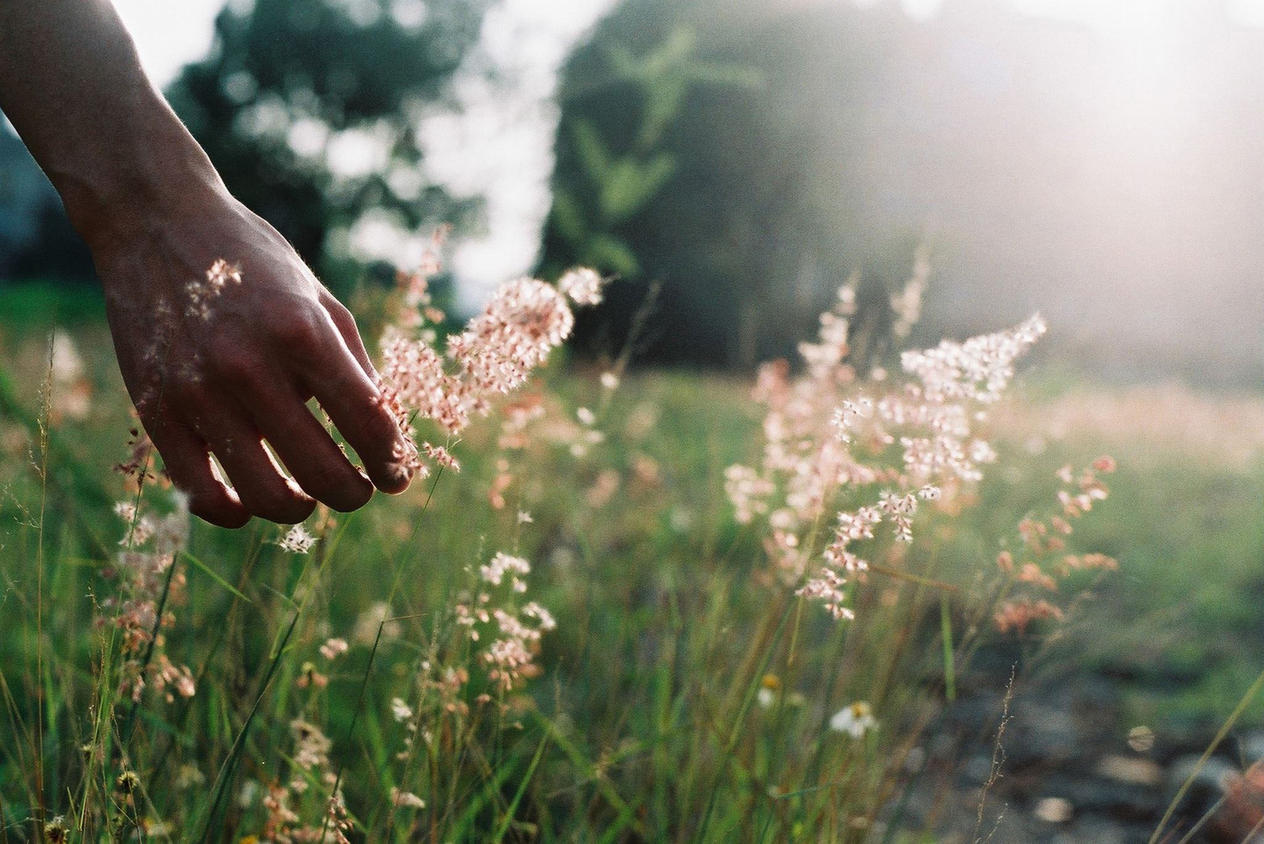
Aesthetic Perception and the Intrinsic Value of Nature
Sandra Shapshay, Department of Philosophy (Hunter College & the Graduate Center, CUNY)
With/In Environments: Reimagining Frameworks and Practices for Environmental Philosophy, The New School for Social Research, 4/14/2022

Slide 2
Some key goals of environmentalists
To preserve wilderness
To protect the health of ecosystems
To save endangered species
To foster a respectful attitude toward nature
More recently, to address issues of environmental justice

Slide 3
The intrinsic value of living entities
“From the perspective of a life-centered theory, we have prima facie moral obligations that are owed to wild plants and animals themselves as members of the Earth’s biotic community. We are morally bound (other things being equal) to protect or promote their good for their sake. … Such obligations are due those living things out of recognition of their inherent worth. They are entirely additional to and independent of the obligations we owe to our fellow humans.”
Paul W. Taylor “The Ethics of Respect for the Environment” Environmental Ethics, 1981, in Andrew Light & Holmes Rolston III, Environmental Ethics (Blackwell, 2003) p. 74 (emphasis added).

Slide 4
The case of the Ram’s Head Lady Slipper

Slide 5
Why should a plant have intrinsic moral value?

Slide 6
Sober’s challenge—the demarcation problem
“The problem for environmentalism stems from the idea that species and ecosystems ought to be preserved for reasons additional to their known value as resources for human use [nutritional, medicinal, recreational, etc.] ...”
“Every ethical theory must provide principles that describe which objects matter for their own sakes and which do not. Besides marking the boundary between these two classes by enumerating a set of ethically relevant properties, an ethical theory must say why the properties named, rather than others, are the ones that count.”
(Elliott Sober, ”Philosophical Problems for Environmentalism” 1988).

Slide 7
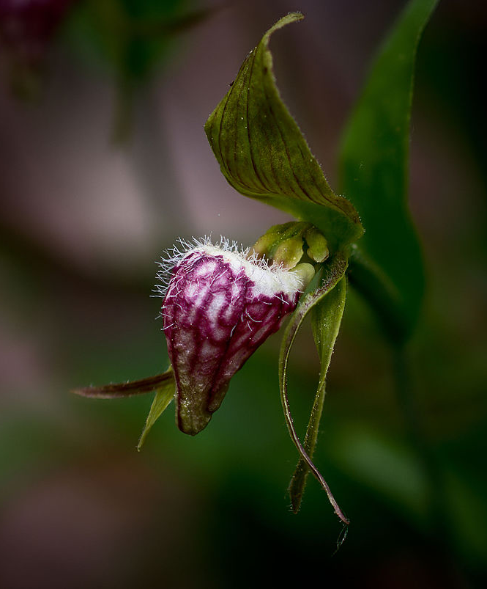
Aesthetic value
“Arguably the only case to be made for its protection is for the peculiar aesthetic properties it possesses, for which reason Nova Scotians have appreciated it both for its flowers and for the contribution its annual appearance makes to the seasonal performances of the woodlands where it is found.”
Jennifer Welchman “Aesthetics of Nature, Constitutive Goods, and Environmental Conservation” JAAC, 2018, pp. 426-7.

Slide 8
3 Problems for the Aesthetic Foundations of Environmental Ethics J. Robert Loftis (2003).
(1) The relative weakness of aesthetic reasons (viz. economic/utilitarian and moral reasons)
(2) The partiality of aesthetic reasons
(3) The anthropocentrism of aesthetic reasons

Slide 9
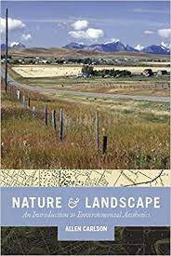
Allen Carlson’s ’scientific cognitivism’

Slide 10
A more aesthetically challenged flower

Slide 11
My proposal
What if the ultimate foundation for environmentalism provided by aesthetic perception is EPISTEMIC insofar as it is through aesthetic perception that the intrinsic value of non-sentient living nature shows up to us?

Slide 12
The case of the NYC pidgeon

Slide 13
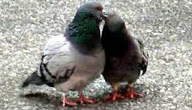
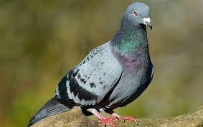
Aesthetic appreciation
“[in paradigmatic cases of aesthetic experience] we attend in a distributed and at the same time focused manner: our attention is focused on one perceptual object [or environment], but it is distributed among a large number of this object’s properties. This way of attending contrasts sharply with the most standard way of exercising our attention (which would be focusing on a limited set of properties of one or more perceptual objects). In other words, this way of attending is special…”
(Bence Nanay, Aesthetics as Philosophy of Perception OUP, 2016, p. 13).

Slide 14
Cognitive stock
“The rock dove (Columba livia), a stout bird with a small head, short neck, and thick gray and white plumage, is almost exclusively the species of pigeon seen in New York City.
Pigeons arrived in America in the 1600s from Europe. Originally raised as a barnyard animal used for their meat, many pigeons escaped and began to thrive in the wild, their populations growing and adapting to city life. Pigeons nest in any nook they can find, including building ledges and the girders of bridges. Their rarely seen young reach adult size after little more than one week of suckling on “pigeon milk”, a thick substance produced in the crop of both of the young’s monogamous parents.
… Although pigeons have a storied past [used as carrier pidgeons in coops during WWII] and many admirers, some call pigeons “flying rats” for their often dirty appearance and diseases acquired by living on the city streets. The acidic droppings of pigeons can eat through limestone and stain brass, thus damaging architecture and statues around the city.”
(NYC Parks Department website,https://www.nycgovparks.org/parks/pigeon-paradise/highlights)

Slide 15
Emotions as perceptions of value

Slide 16
Emotions as perceptions of value

Slide 17
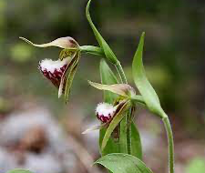
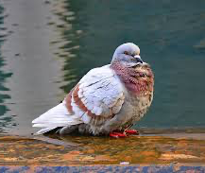
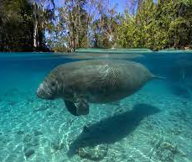
Tracking or projecting value?

Slide 18
Conclusion
The deepest contribution to environmental ethics made by aesthetics is actually EPISTEMIC.
A serious, cognitively rich aesthetic appreciation of nature is one that, in arousing the emotion of wonder at the natural world, REVEALS the intrinsic value of nature.

